Slide 1

Terna Engineering College Computer Engineering Department Mini Project Generate Password with Python
By
ANIKET MAHADEV GAWADE id:-TU2F1920082
Under the Guidance of : nilesh sir

Slide 2
Index
1.Introduction
2. Literature Survey
3. Problem Statement
3. Objectives
4. Scope
5. Proposed Methodology
6. System architecture
7. Tools and Dataset Required
8. implementation snapshots
9. Conclusion
References

Slide 3
introduction
Python is an interpreted high-level general-purpose programming language. Python's design philosophy emphasizes code readability with its notable use of significant indentation. Its language constructs as well as its object-oriented approach aim to help programmers write clear, logical code for small and large-scale projects.[29]
Python is dynamically-typed and garbage-collected. It supports multiple programming paradigms, including structured (particularly, procedural), object-oriented and functional programming. Python is often described as a "batteries included" language due to its comprehensive standard library

Slide 4
Literature Survey
While there are many examples of "random" password generator programs available on the Internet, generating randomness can be tricky and many programs do not generate random characters in a way that ensures strong security. A common recommendation is to use open source security tools where possible since they allow independent checks on the quality of the methods used. Note that simply generating a password at random does not ensure the password is a strong password, because it is possible, although highly unlikely, to generate an easily guessed or cracked password. In fact, there is no need at all for a password to have been produced by a perfectly random process: it just needs to be sufficiently difficult to guess.

Slide 5
Problem Statement
To save time creating a difficult Password we use Random password generator using python.
Objectives
Passwords are critical for cyber security. A good password must have at least 8 random characters in length
and should contain lower case letters, upper case letters, numbers and at least one special character.

Slide 6
Scope
A random password generator is a software program, hardware device, or online tool that automatically generates
a password using parameters that a user sets, including mixed-case letters, numbers, symbols, pronounceability, length,
and strength.
Proposed Methodology
We can generate a random string password with letters, special characters, and digits using the following two ways.
• Combine the following three constants and use them as a data source for the random.choice() function to select
random characters from it.
• string.ascii_letters: To include letters from a-z and A-Z
•string.digits: To include digits from 1 to 10
•string.punctuation: to get special symbols
•Use the string.printable constant and choice() function. The string.printable contains a combination of digits,
ascii_letters (lowercase and uppercase letters), punctuation, and whitespace.

Slide 7
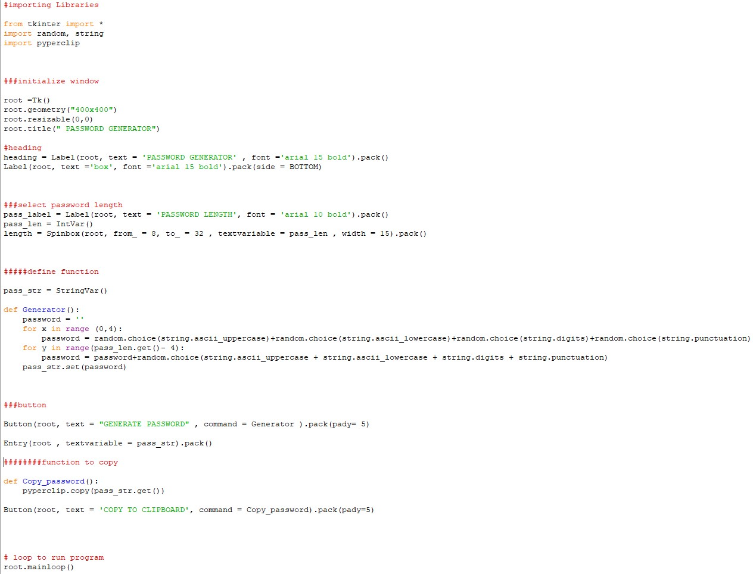
System architecture

Slide 8
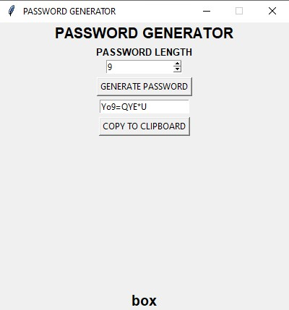
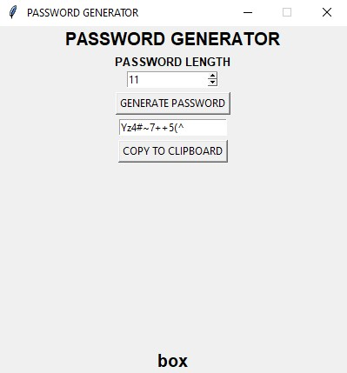
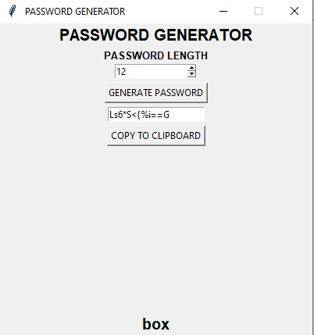
Implementation snapshots
Conclusion
Thus we can create random password using Python.
References
google

Slide 9
THANK YOU

